Slide 1
The Bee Treats E-Commerce Platform
www.thebeetreats.com
Made By :- Tanveer Singh Puniah
A Project by Spectra Computech Pvt. Ltd.

Slide 2
Introduction to The Beetreats
The Bee Treats is an e-commerce platform for honey-based products, providing high-quality natural goods with a seamless shopping experience. The project involves building a scalable, secure, and user-friendly system for customers worldwide.
The Bee Treats Project:
robust e-commerce platform for natural honey products.
Focused on scalability, security, and user-friendly design.
Developed using Laravel, MySQL, and Bootstrap.
Key Features:
Seamless shopping experience.
Secure payment gateways.
Efficient product and order management.

Slide 3
Objectives
Develop a secure e-commerce platform.
Provide a smooth shopping experience.
Integrate essential features like cart, checkout, and secure payment.
Enhance customer engagement through blogs, testimonials, and social links.
Primary Goals:
Build a scalable and secure platform.
Enhance user experience through intuitive design.
Enable efficient order and inventory management.
Integrate secure payment systems.
Why This Project?
Rising e-commerce demand for niche products.
Providing accessibility and convenience to customers.

Slide 4
Tools & Technologies
Backend: Laravel (PHP Framework)
Frontend: HTML, CSS, JavaScript, Bootstrap
Database: MySQL
Payment Gateway: Razorpay
Server: Localhost (XAMPP) / Hostinger
Development Tools: VS Code, GitHub, XAMPP

Slide 5
Key Features
1st Features | 2nd Features | 3rd Features | 4th Features | 5th Features | 6th Features
User Registration and Login | Product Browsing and Filtering | Add to Cart and Wishlist | Secure Online Payments | Blog Integration for User Engagement | Admin Dashboard for Management

Slide 6
Challenges Faced
Database Optimization:
Ensuring smooth operations with relational data.
Payment Integration:
Configuring Razorpay API.
User Experience:
Balancing design and functionality.
Resolutions:
Iterative testing and debugging.
Collaboration and research.

Slide 7
Key Takeaways and Future Scope
Key Takeaways:
Mastered Laravel framework and database management.
Successfully implemented an e-commerce platform.
Enhanced skills in system integration and UI/UX design.
Future Scope:
Add advanced analytics for sales tracking.
Introduce mobile app compatibility.

Slide 8
Challenges Faced
Database Optimization:
Ensuring smooth operations with relational data.
Payment Integration:
Configuring Razorpay API.
User Experience:
Balancing design and functionality.
Resolutions:
Iterative testing and debugging.
Collaboration and research.

Slide 9
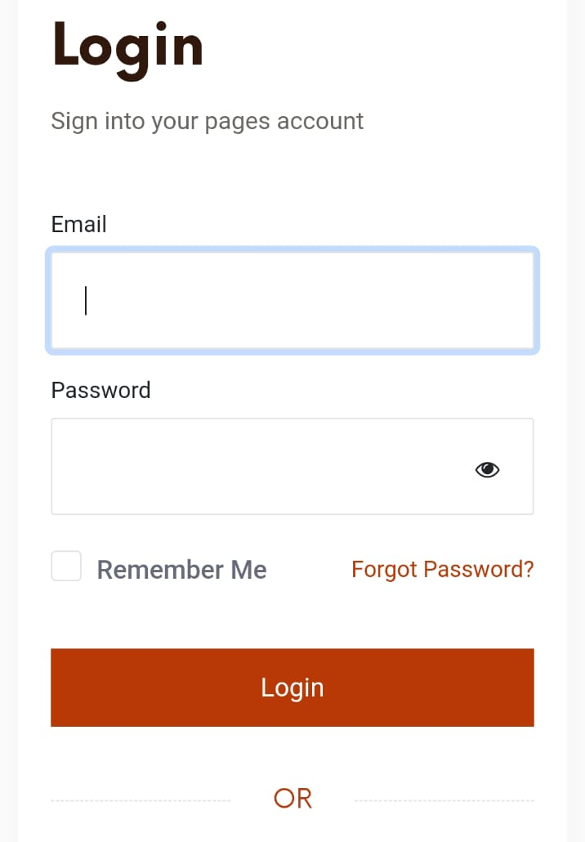
User Authentication and Authorization
The Beetreats provides secure user registration and login functionalities, allowing customers to create accounts, manage their profiles, and track their orders.
The website employs robust authentication measures, including password hashing and secure session management, to safeguard user accounts and sensitive information.
Authorization controls ensure that only authorized users can access specific features and functionalities, maintaining data integrity and preventing unauthorized access.

Slide 10
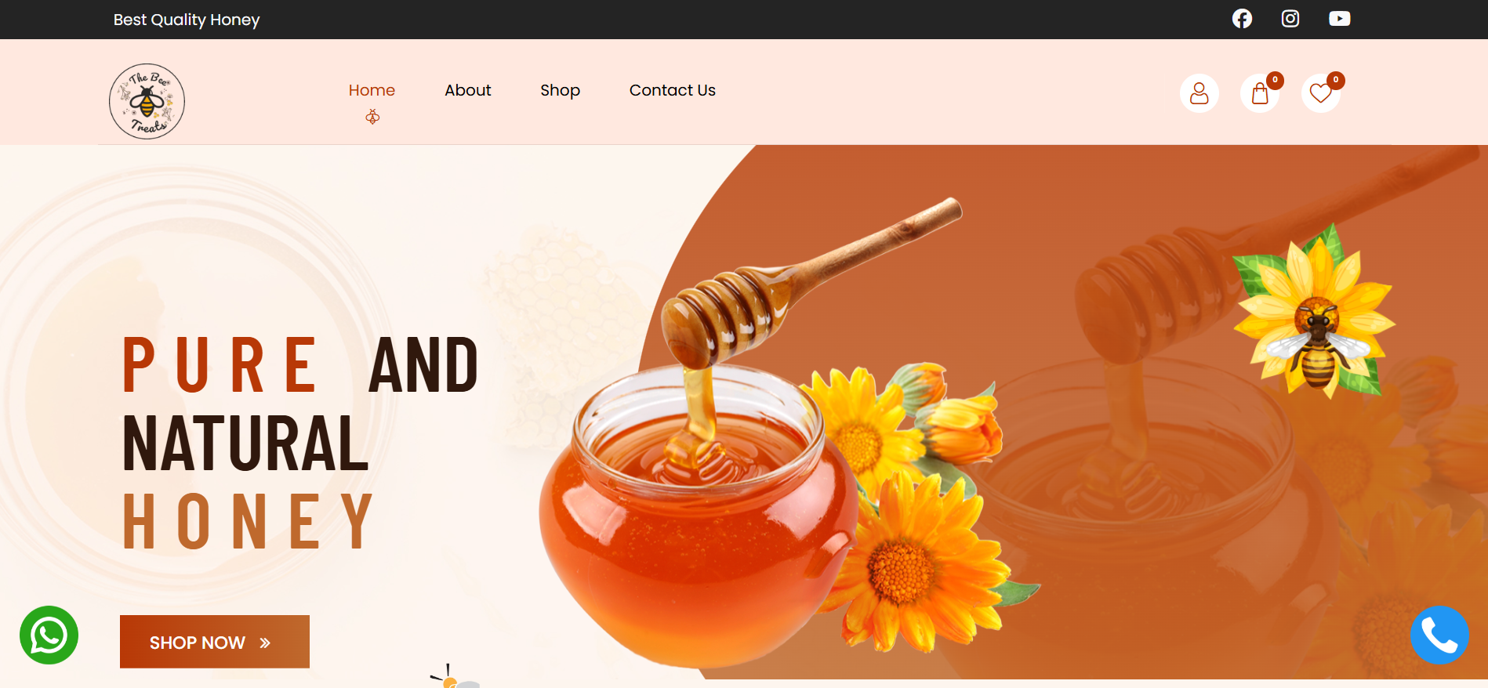
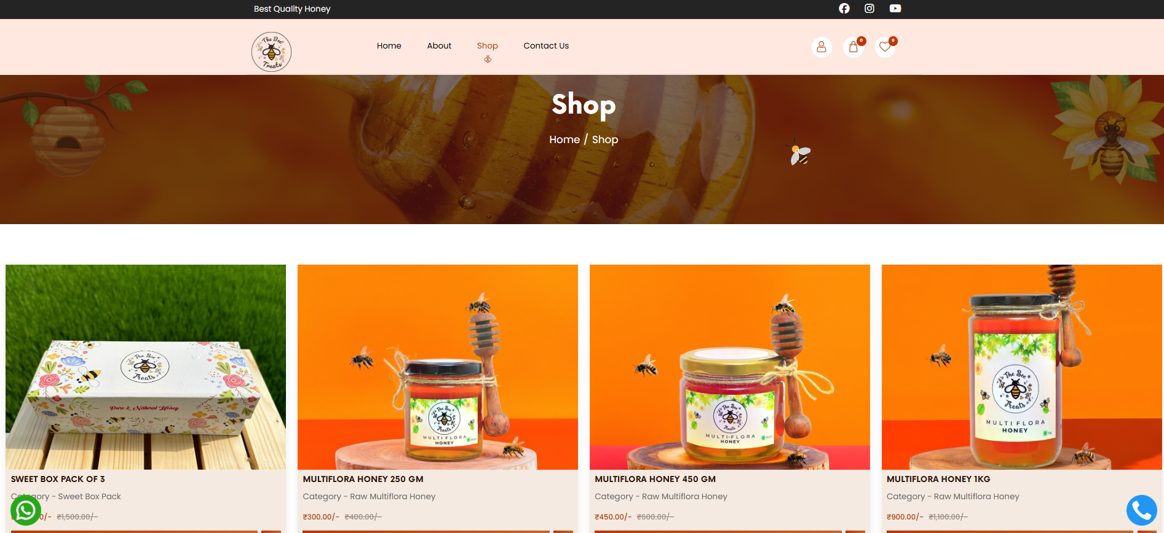
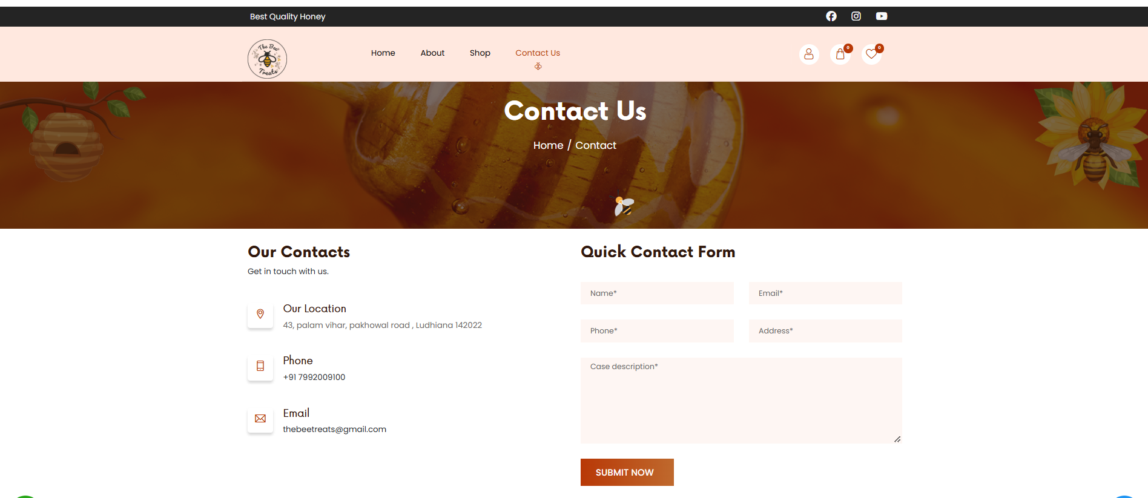
Outputs

Slide 11
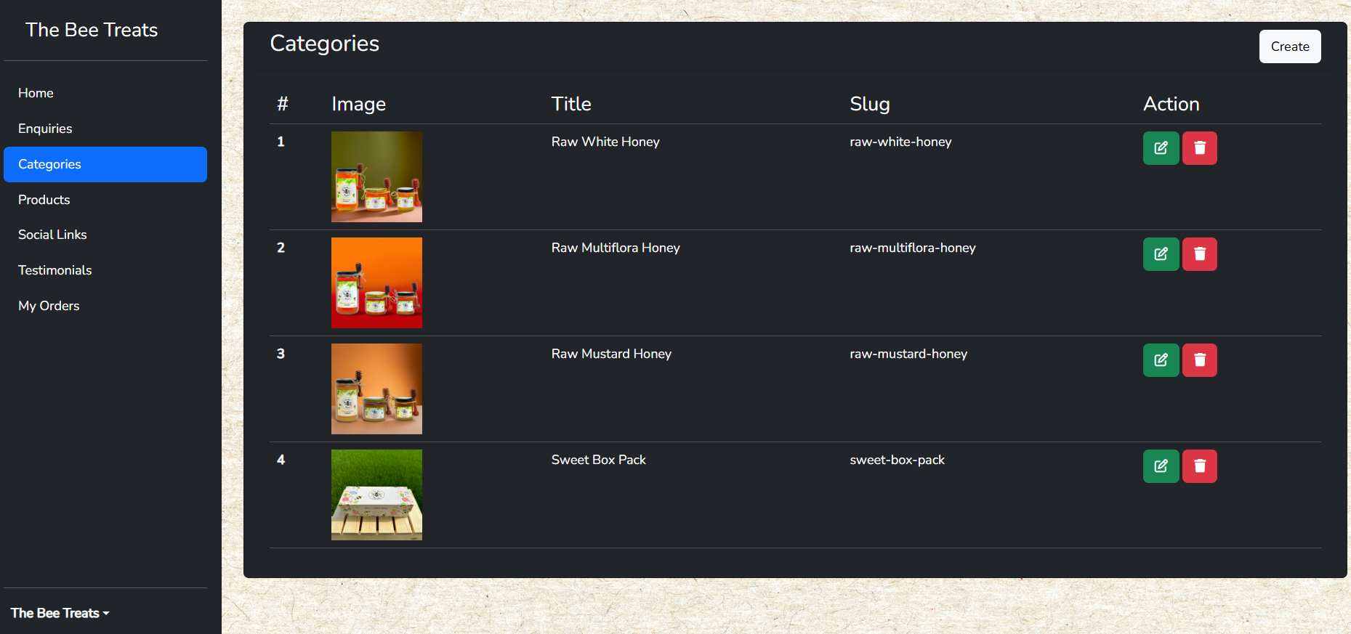
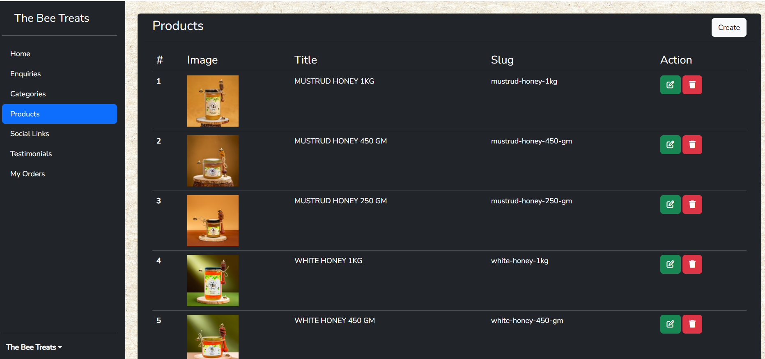
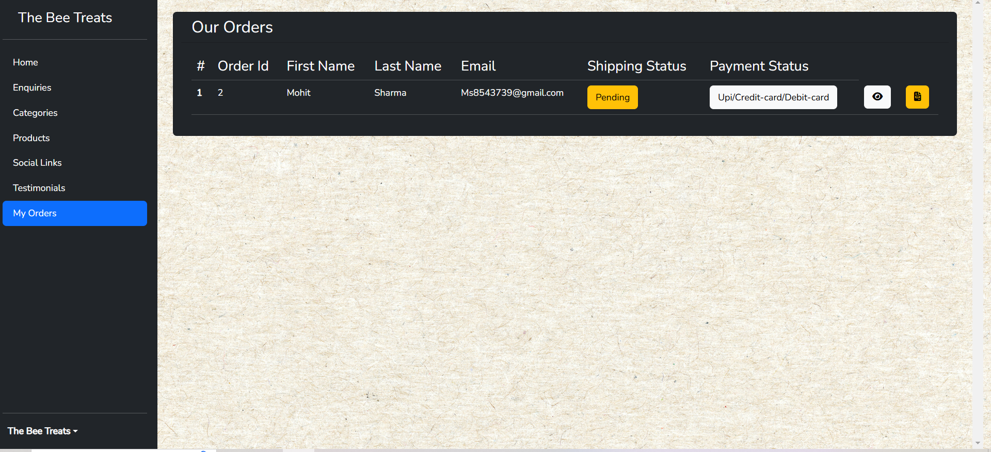
Outputs (Admin Dashboard)

Slide 12
Thank You
Name : Tanveer Singh Puniah

